Slide 1
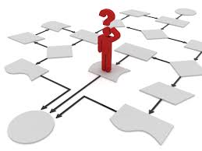
It’s time to think about the user!

Slide 2
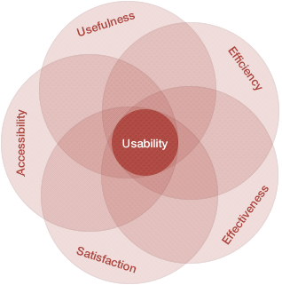
“In an age of fast-growing complexity, the winners are those who simplify the lives of others”

Slide 3
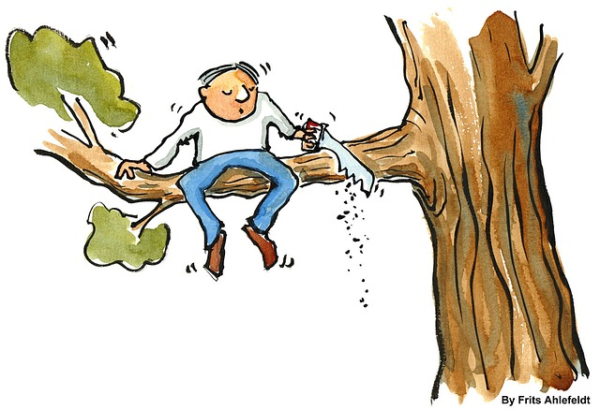
Understanding the user view
“Winning and awarding contracts is important
for the health and performance of the business”
98% agree
(the other 2% are busy sawing!)

Slide 4
Understanding the user experience
“Contracts contain important information that is directly relevant to how I do my job”
72% agree or strongly agree
"It's the relationship that matters. I never use the contract once it's signed" (Category Manager, Consumer Goods)
"The data from our contracts feeds into just about every system in the business. It's critical to the way we perform, the margins we achieve and the satisfaction of my customer" (Account Executive, IT outsourcing)

Slide 5
Understanding the user experience
“Contracts are easy to access and I'm confident I can find the current and complete version”
52% agree or strongly agree
"Sometimes it's difficult to find anything. Recently I had to ask a supplier for their copy of our agreement. Embarrassing“ (In-house counsel, Telecommunications)
"Our central repository works well - it's easy to find and easy to upload new content. We are starting to manage communications from within the system and that's making a huge difference to reliability“ (Project Manager, Construction)

Slide 6
Understanding the user experience
“When I need help or guidance in understanding or interpreting the implications of a contract, I know where to access the information or help that I need”
43% agree or strongly agree
"It's really difficult to find the right person and when you do, they're always busy.“ (Operations Manager, Financial Services)
"My contracts and legal team produced a series of on-demand apps. That's made things much faster and easier.“ (Sales Manager, Facilities Management)

Slide 7
Understanding the user experience
“Overall, I am satisfied with the contracting process and the way it supports my personal performance”
17% agree or strongly agree
"I'm not sure there is a process - it seems really inconsistent and frustrating“ (Business Operations Manager, Oil & Gas)
"Since we automated, there has been a massive improvement. Contracting no longer feels like mountain climbing!” (Business Development Director, Aerospace)

Slide 8
Understanding the user experience
“Contracts are easy to understand”
12% agree or strongly agree
"Are they? Who for?“ (Program Executive, Public Sector)
"We have an obligation management system which has allowed me to focus on what I need to know and do. I used to worry all the time about what I was missing“ (HR Manager, Outsourcing)

Slide 9
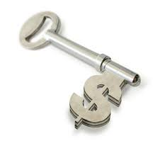
Executive Problem Statement
Too many trading relationships and projects under-perform. ‘Commercial excellence’ and ‘contracting competence’ are increasingly understood to be key to their improvement.
The challenge: how can we move rapidly in that direction, in an environment of increasing complexity, where old approaches are no longer keeping up with new needs and demands?
Is the challenge:
Fit for purpose process?
Fit for purpose contracts & relationships?
Fit for purpose personnel?
Fit for purpose measures?
Fit for purpose tools?

Slide 10
We know it is coming … Future of Contracting 2016

Slide 11
And that we need new approaches

Slide 12
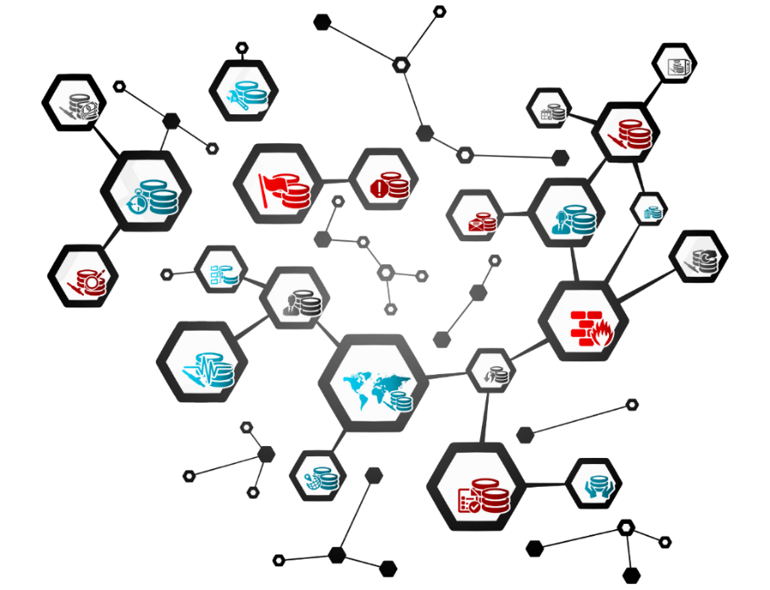
How is emerging communication impacting trade?
‘The virtual enterprise’ - supply networks are more interdependent
Society is increasingly focused on outcomes
Rules are designed to drive behaviour and define relationships
Collaboration is needed to manage risk and ensure sustainability
Communications are designed for users and to support value delivery
Data is a source of business intelligence and proactive change
… and traditional contracting based on
classical legal theory simply does not support
the trading relationships of today

Slide 13
Rethinking the purpose of a contract: equipping contract owners for success
Economic Asset
Allocate risks
Support communications
Direct operations
Drive behaviours
Legal weapon

Slide 14
From analog to digital …..

Slide 15
Contracts and technology … a convergence

