Slide 1
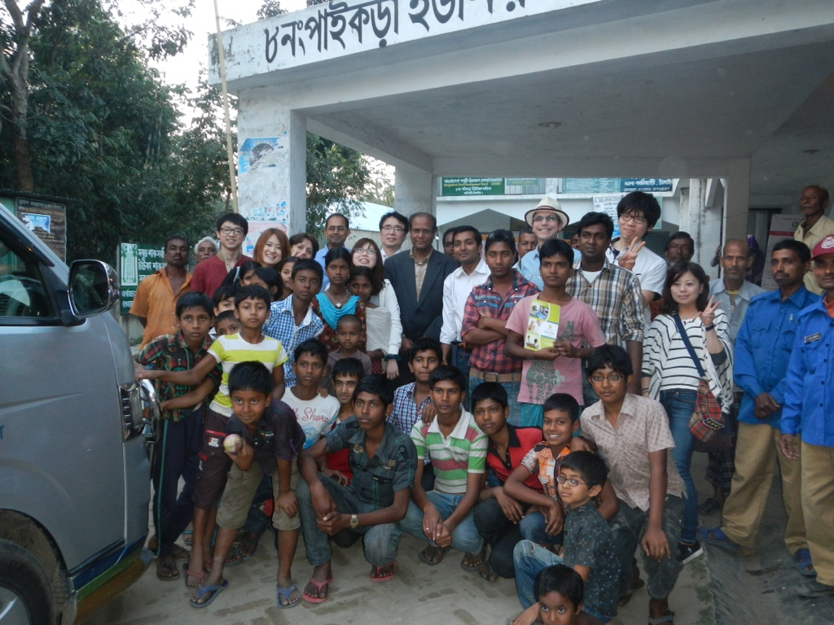
Do you want to set up a Social Business?
Andrew Rebeiro-Hargrave
Academic Visitor, Aalto University, School of Science
Department of Industrial Engineering and Manaagement

Slide 2

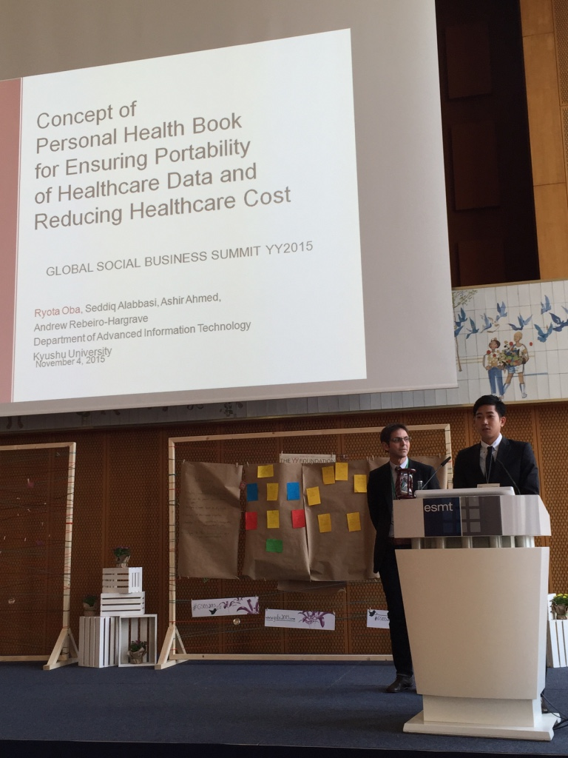
Agenda
Social Business and Social Enterprise Industry
Engineering Social Capital
Manufacturing Social Impact Measures
Social Impact Bonds
Getting involved
Institute of Decision Science for a Sustainable Society, Berlin 2015

Slide 3
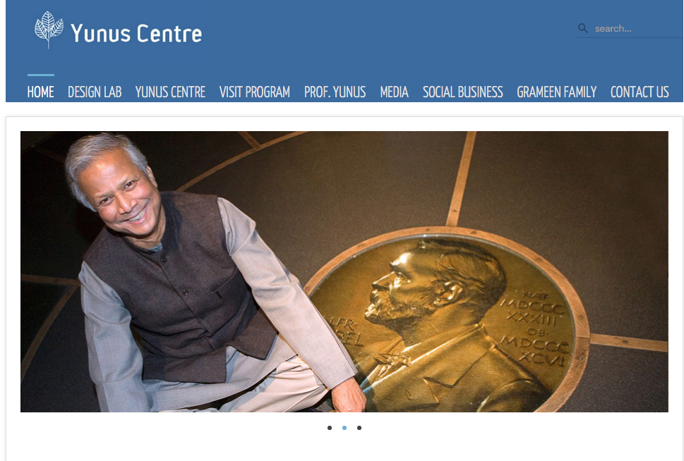



My Introduction to Social Business
Social Business and
Social Enterprise Industry
Professor Mohammad Yunus Nobel Laureate

Slide 4
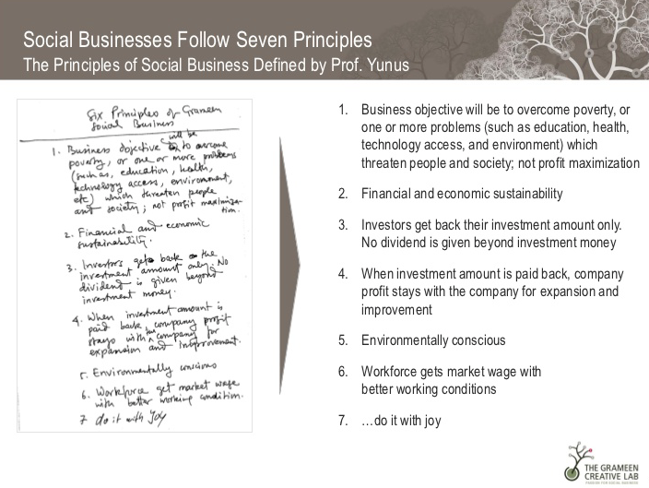
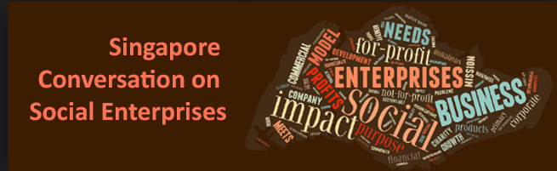
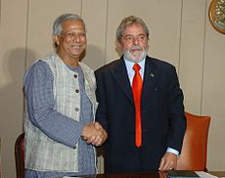

Slide 5


Social Enterprise Definition
Social Enterprise is a business that trades to achieve explicit social aims
Social enterprises create social change and begin with the dreams and aspirations of people and communities
Social Entrepreneurs develop innovative solutions to society’s most significant problems
Solving or eliminating a significant social problem requires addressing its root cause (s)
Addressing the root cause (s) of a significant social problem requires more than incremental change, e.g., change that addresses only part of the problem and/or change that cannot be sustained over time.

Slide 6
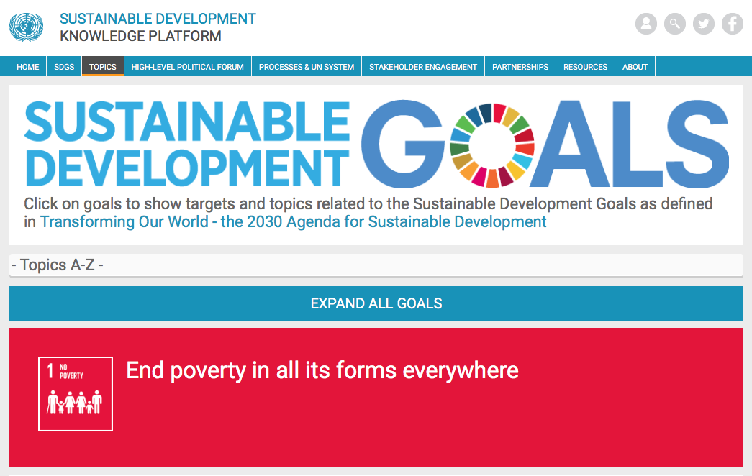
What are society’s most significant problems?

Slide 7

Social Businesses need to engineer, manufacture and export
products to meet social and ecologically demand

Slide 8
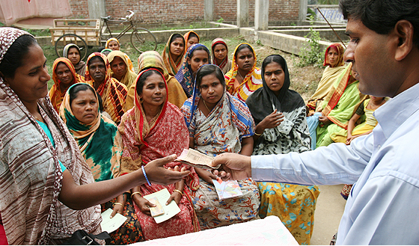
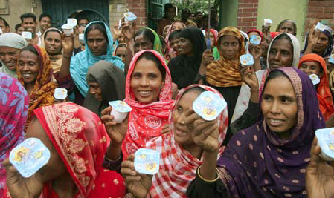
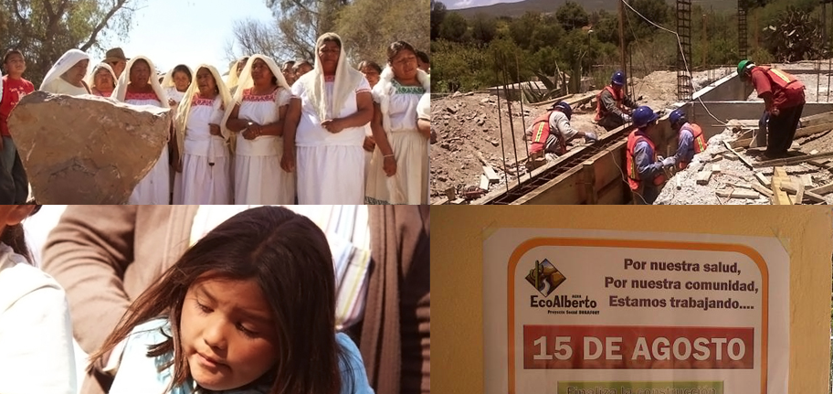
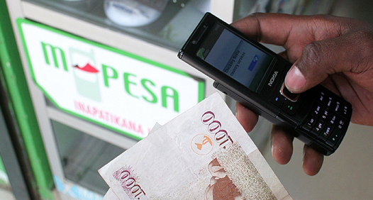
Social Business Customers
7.06 million borrowers
97 per cent of them are women.
Micro Finance (Grameen Bank), Bangladesh
Danone Youghart
20 million M Pesa subscribers
Safaricom, Kenya
Mexico
Mobile Money

Slide 9

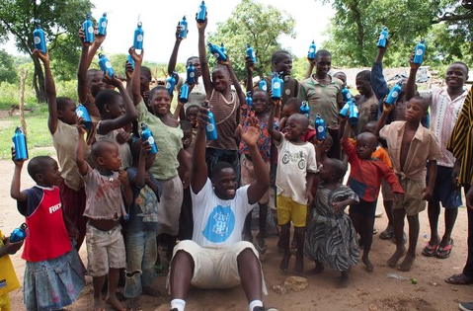
Social Enterprises and clean water in Africa
Magic Straw for water
Clean water bottle

Slide 10
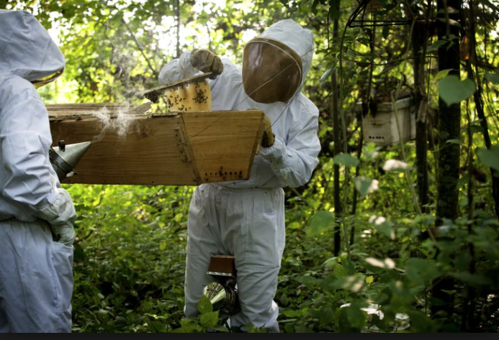
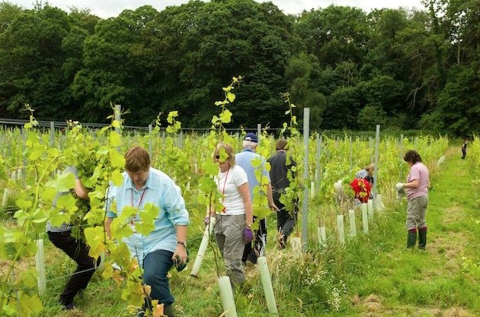
Social Enterprises in UK
Sparkling wine vineyard in London
Beekeeping

Slide 11



Jamie Oliver’s Social Enterprise

Slide 12
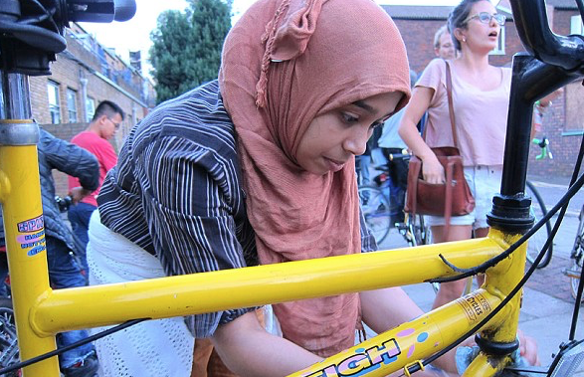
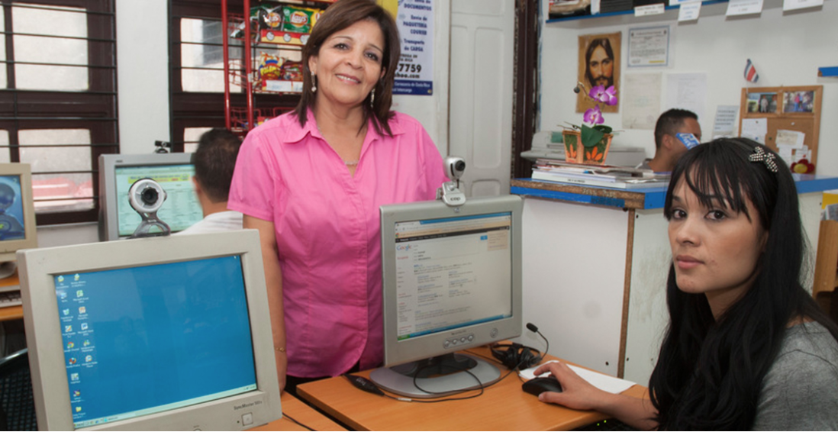
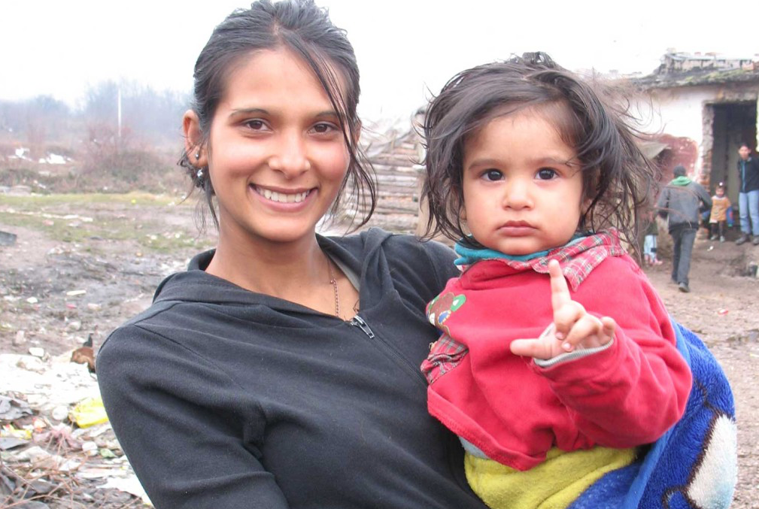
Social Enterprises
in Europe
Bulgaria
Refugee training

Slide 13
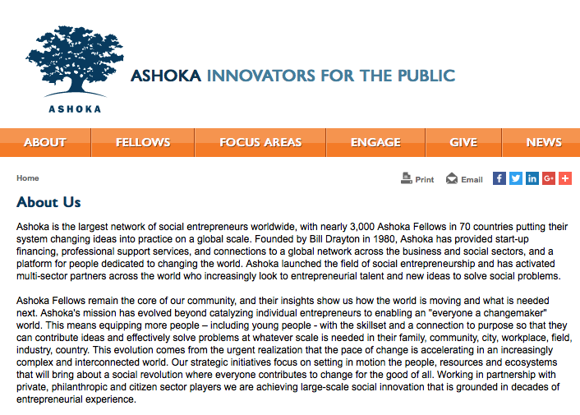
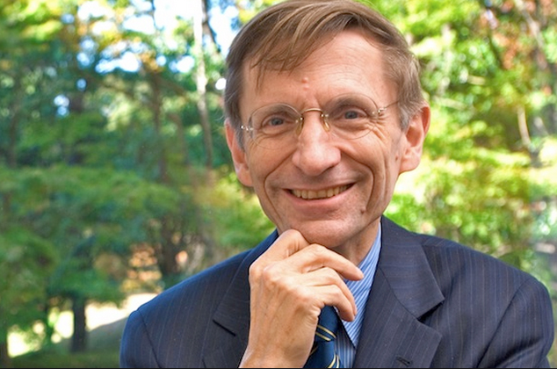
Social Enterprises Industry growth in Asia
Bill Drayton founder

Slide 14

Social Enterprises Industry in the UK
2005 - Small Business Survey (SBS) estimated that 1.2 per cent of all business were Social Enterprises, equating to 15,000 business’ £27 billion turnover
2009 - Social Enterprise UK calculated that by there were approximately 62,000 social enterprises in the UK.
2013 - There were 80,000 Social enterprises
Delta Economics employ a wider definition of social enterprise estimating that the sector provides over 2.09m jobs in the UK economy raising the figures of SE’s to 232,000.
2014 – Co-ops with 12.9 million members, providing 237,800 jobs turnover of £36.7 billion
It is clear from these figures that social enterprise is playing an increasingly significant role in the UK economy.

Slide 15
WHY GROWTH SOCIAL BUSINESS/ENTERPRISE INDUSTRY?
Public Budgets, in both developed and developing nations are increasingly stressed by:
  social challenges associated with either aging populations; population growth; immigration
  environmental challenges associated with air pollution, climate change, e.g., water shortages, etc.
  economic challenges associated with slow growth and/or the global economy (shareholder asset investment bubbles, fallen wages, unemployment)
©2015 GCSEN Foundation

Slide 16
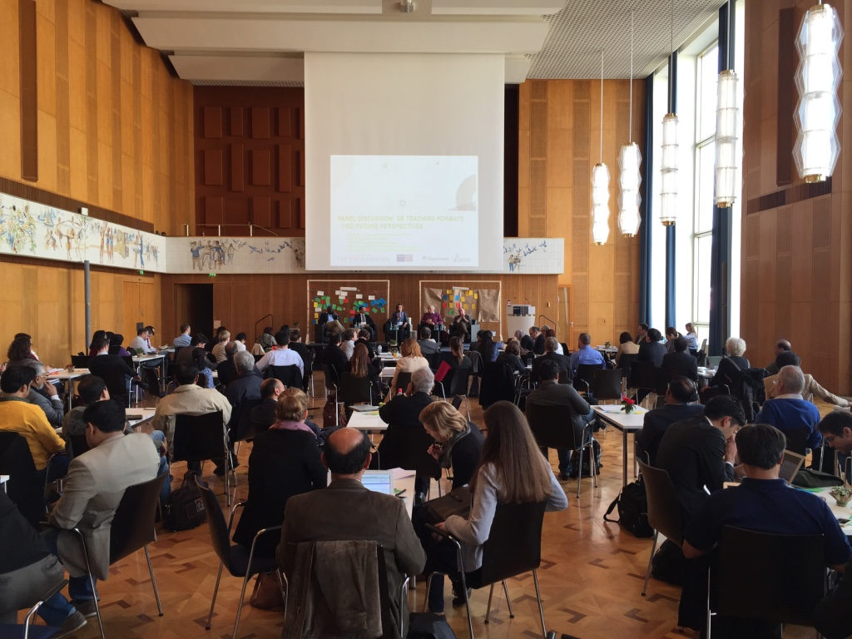
If you have a Social Business case study, you can submit to the
Social Business Academic International Conference
hosted by Alibarba in China 11.2016

Slide 17
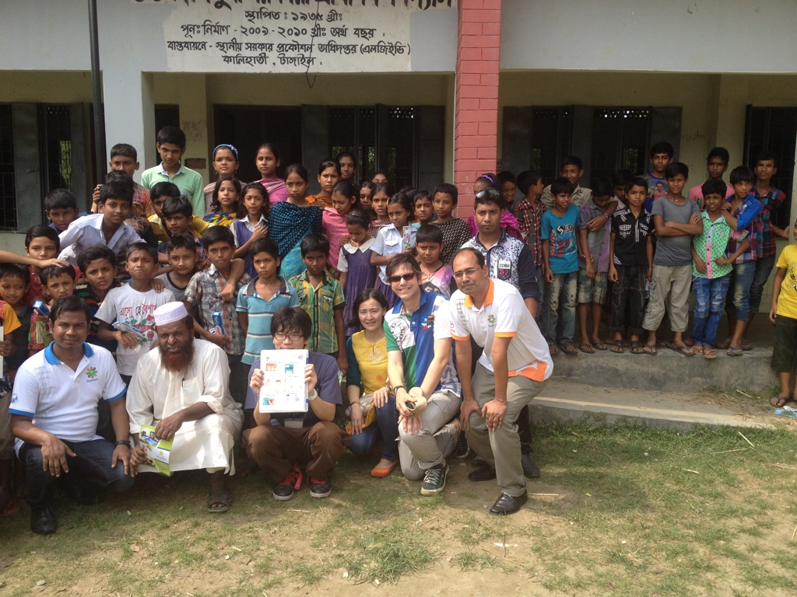
Engineering
Social capital

Slide 18
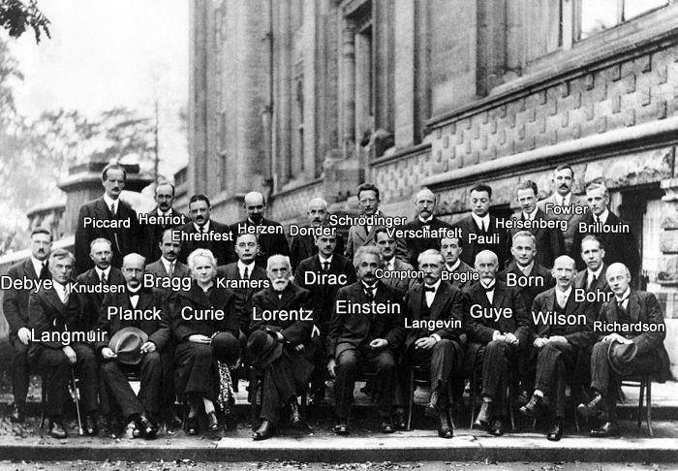
Social Capital is a machine that does things
Social capital refers to the collective value of all “social networks” [who people know] and the inclinations [including mutual assistance] that arise from these networks to do things for each other ["norms of reciprocity"].
Specific benefits that flow from the trust, reciprocity, information, and cooperation associated with social networks. Social capital creates value for the people who are connected and – at least sometimes – for bystanders as well.
Information flows depend on social capital norms of reciprocity (mutual aid) and are dependent on social networks.
  Bonding (or “cohesion”) networks that connect people who are similar, sustain particularized (in-group) reciprocity.
  Bridging (or “heterogeneity”) networks that connect individuals who are diverse, sustain generalized reciprocity.
Collective action depends upon social networks although collective action also can foster new networks. Broader identities and solidarity are encouraged by social networks that help translate an “I” mentality into a “we” mentality.

Slide 19
The Smartest Social Capital Network Ever!

Slide 20
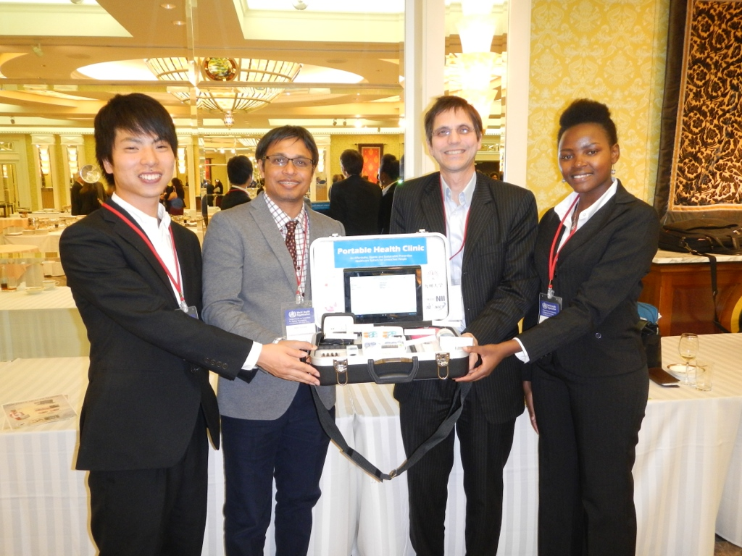
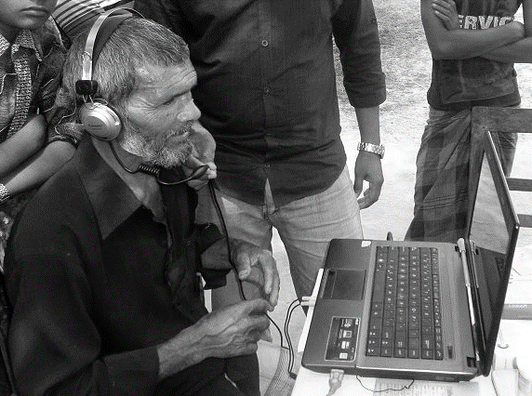
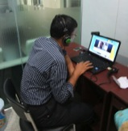
Bringing digital screening and telemedicine to remote communities
Portable Health Clinic demonstrated to WHO, Kobe 2014.
Can we deploy it in Nordic environment?

Slide 21
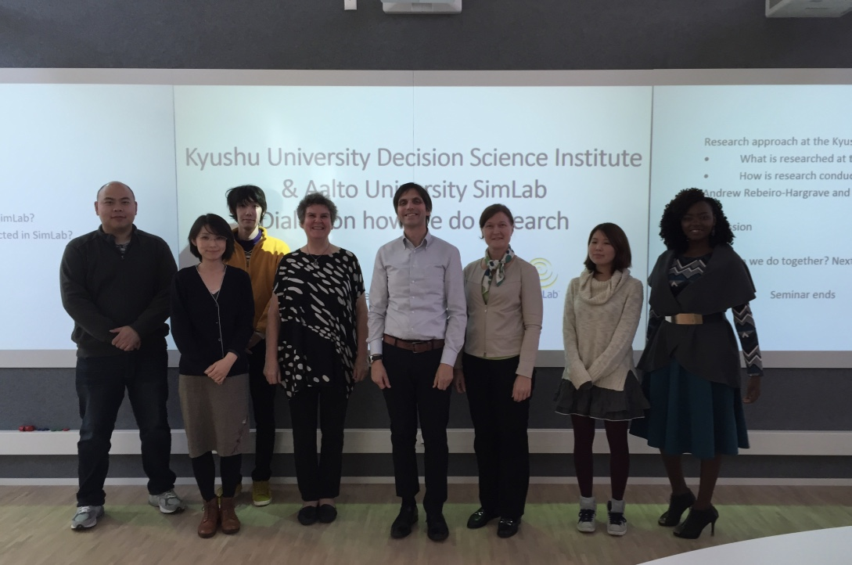
Designing, Building, Social Capital for E-Health Social Business in Finland

Slide 22
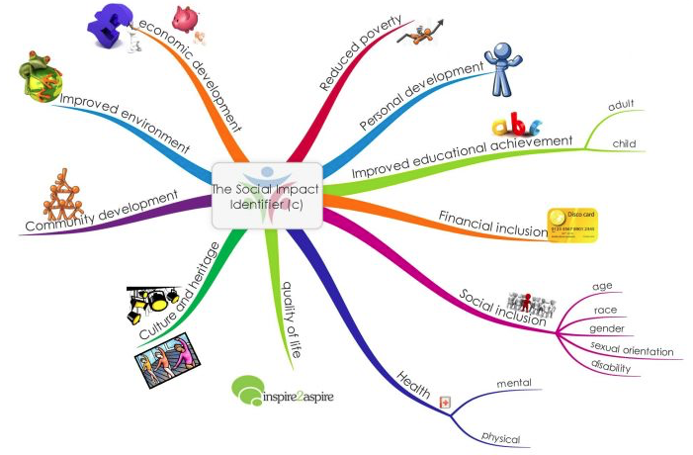
Manufacturing Social Impact measures (Digitization)

Slide 23
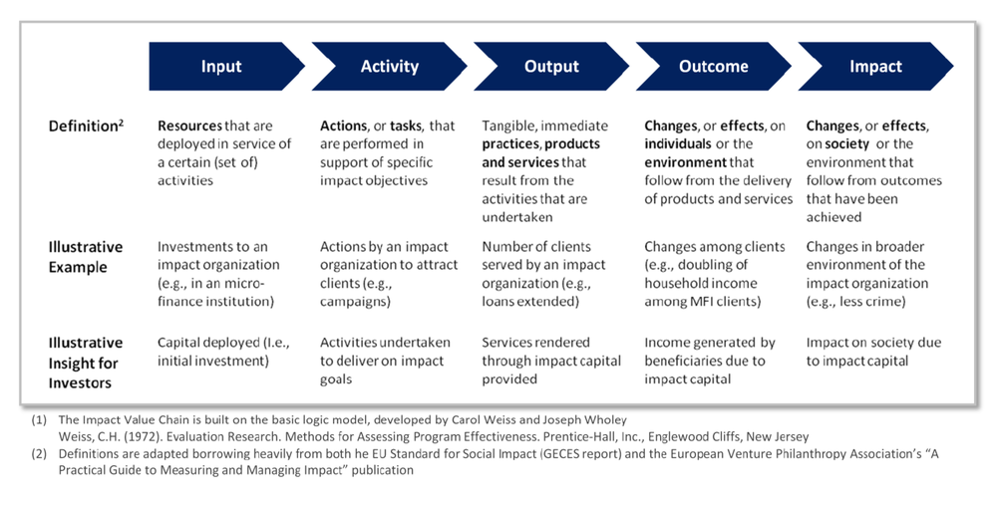
Logical Models: Theory of Change
19

Slide 24
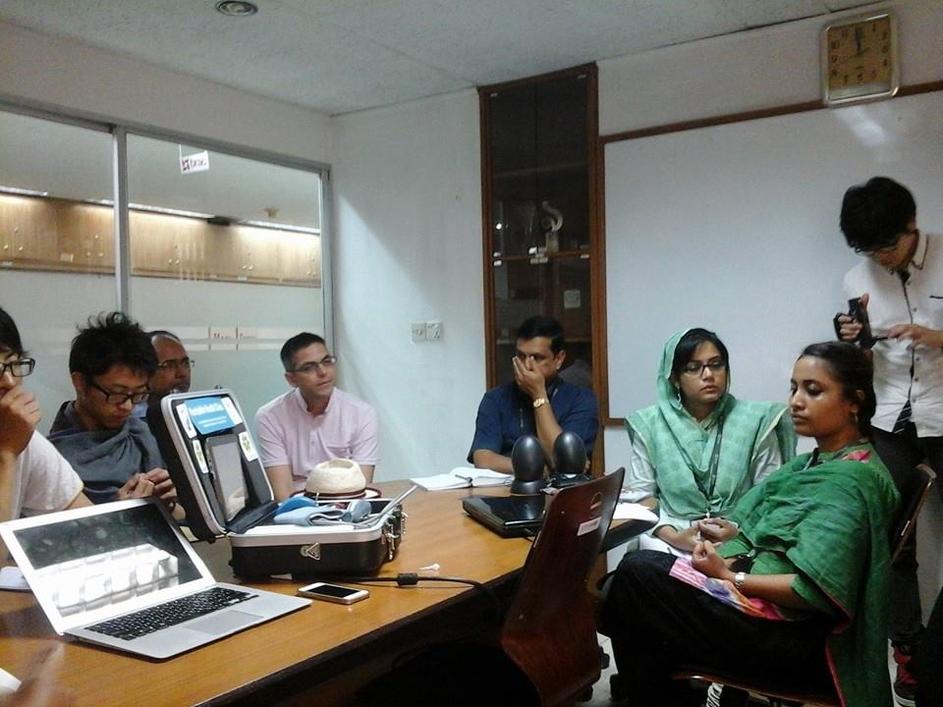
Co-Producing e-Health Social Business in Finland

Slide 25
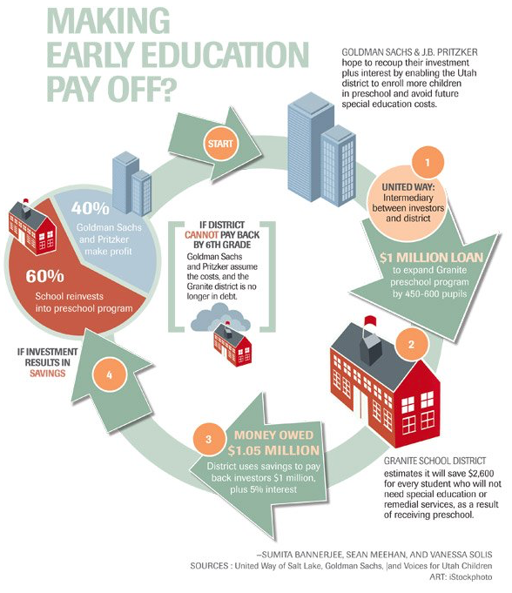
Social impact bonds (SIB)

Slide 26
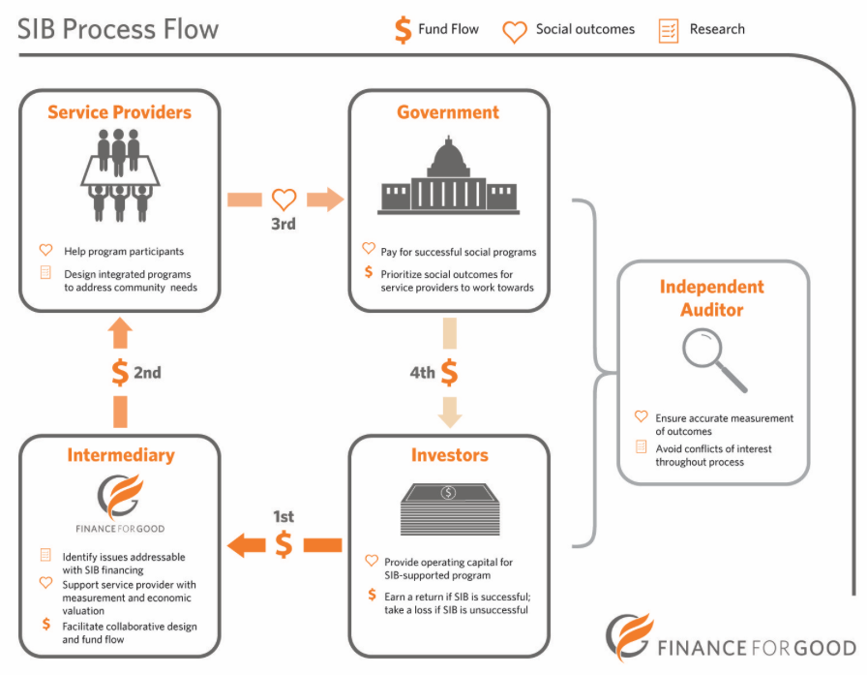

Slide 27
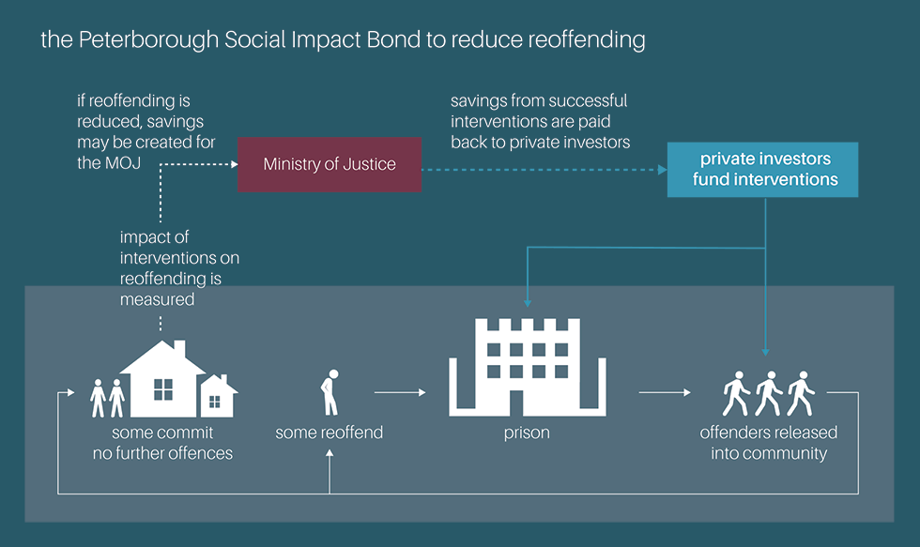
Social Impact Bond in UK example

Slide 28
Almost 40 Social Impact Bonds Worldwide in development
Canada
Various SIBs in exploration at the National level
Scotland
Government exploring SIBs in two sectors
Ireland
Government exploring SIBs in 5 topic areas
United Kingdom
Home of 1st SIB
14 SIBs overall, multiple sectors
Germany
Initial interest in SIBs
USA
Federal government designing 3 SIBs
NYC launched SIB on recidivism
Massachusetts 2 SIBs
SIBs being developed in 7 States
Israel
3 SIBs under design
India
SIB for education of girls
Colombia
SIBs en exploration for women’s health and primary education
Australia
New South Wales designing 3 SIBs in recidivism and foster care
Rwanda
SIB under exploration
Uganda
SIB with DFID y Social Finance in design for sleeping sickness
South Africa
SIB in criminal justice in Cape Town
Mozambique
SIB to combat malaria with financing from mining companies
Source: Information provided by Instiglio

Slide 29
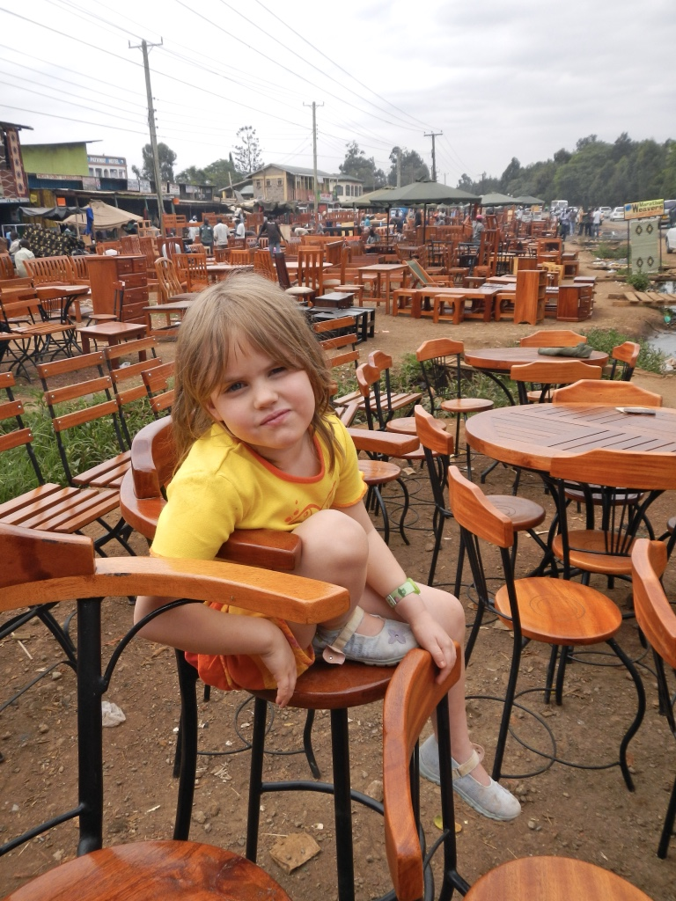
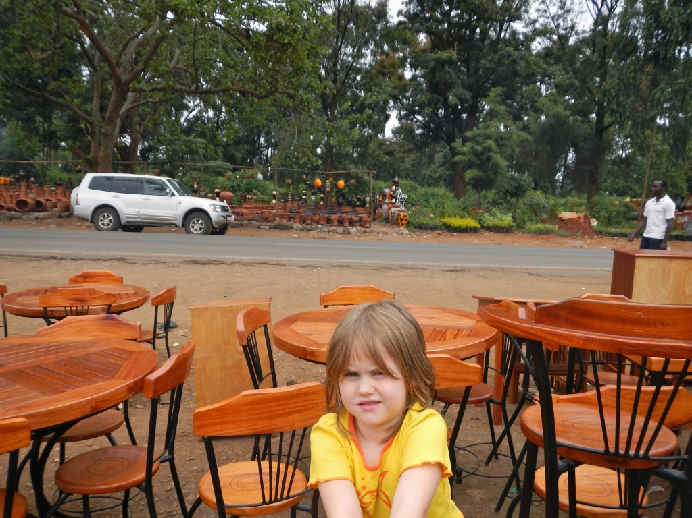
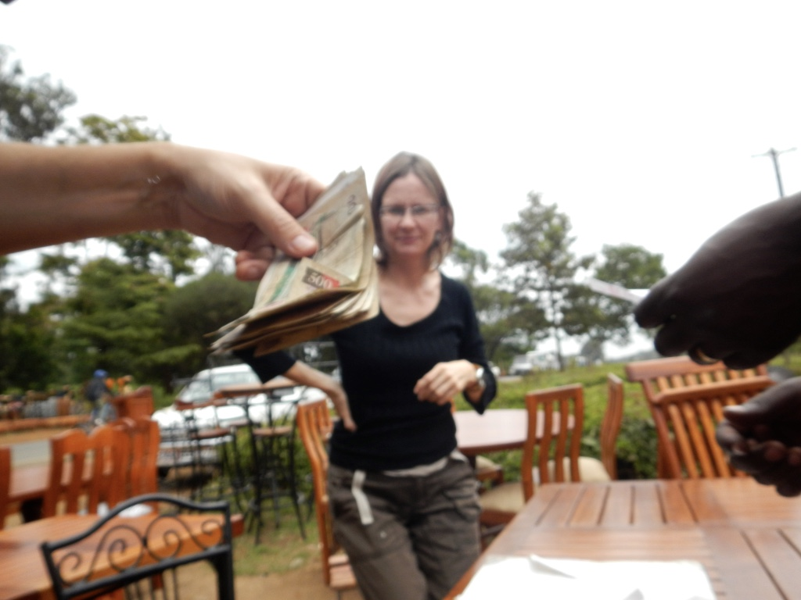
Getting involved

Slide 30
4 Questions to ask nonprofits:
So you want to be a social entrepreneur,
What SOCIAL VALUE are you creating?
What is your BUSINESS MODEL?
How do you SCALE?
How do you stay SUSTAINABLE?

Slide 31
Creating Social Value
Value most often measured in terms of profit
Social Value measures impact- ability to generate positive externalities
Examples: Enhancing human capabilities, increasing freedom, build levels of trust
Competitive Advantage: What do you do and create that has more value to society?
KEY: Be able to measure it in quantifiable terms
Notes:
beneficial outcome that creates broader productive environmental and societal externalities
Outcomes, not outputs
This is what you measure!

Slide 32
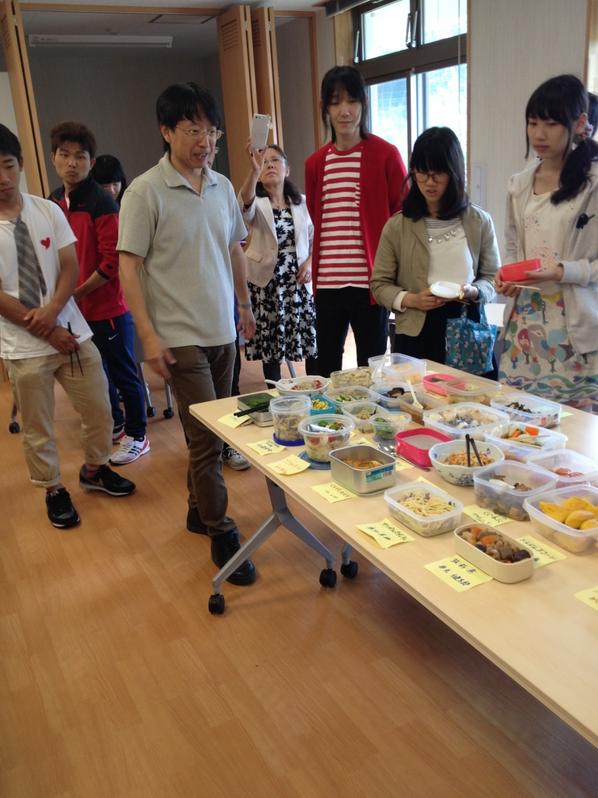
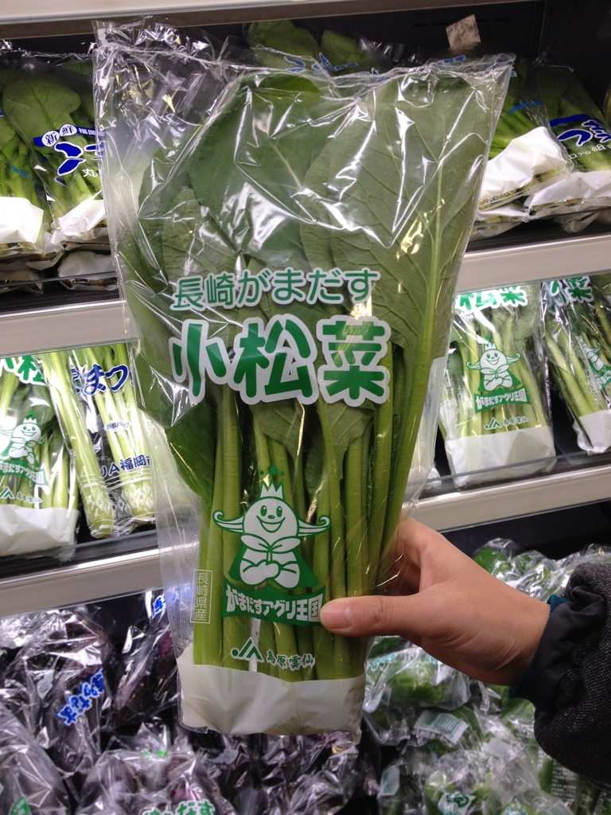
Bento School with focus on nutrition, home cooking, local organic food

Slide 33
Map the relationship between the Social Business and the Client
Co-Creation (economic strategy)
Social
Business
Business Policy
Client Policy
Investment Policy
Student
Curriculum, budget
Location, experience, marketing
Certification, staff, cash-flow
Value
Co-Design
Co-Production
Co-Commercialization
Graduation,
Bento gakusei (student) learning environment
Bento gakusei (student) input to curriculum
Registration to bento ‘nutrition’ course and contribution to sustainable agricultural practices

Slide 34
Design and build a Social Network and extract social capital
Business
Sector
Governance
Japanese
Cooks
Legal
School
Board
Helsinki
School
Finnish
Bank
Finnish
Partners
Biz
Plan
Invest
Plan
Co-Creation
Co-Design
Co-Production
Kyushu
Advisor
Mentors
Japanese
Partners
Fukuoka
Student
Bento
Supplier
Client
Plan
Community
(Helsinki)
Node properties
Problem definition
Goal definition
Knowledge
Bias
School
Non
School
Staff
Student
Mothers
Refugee
Communication:
Frequency
Timely
Accurate

Slide 35
Set measurable business targets for the Social Business

Slide 36
Set collaboration targets for the Social Business

Slide 37
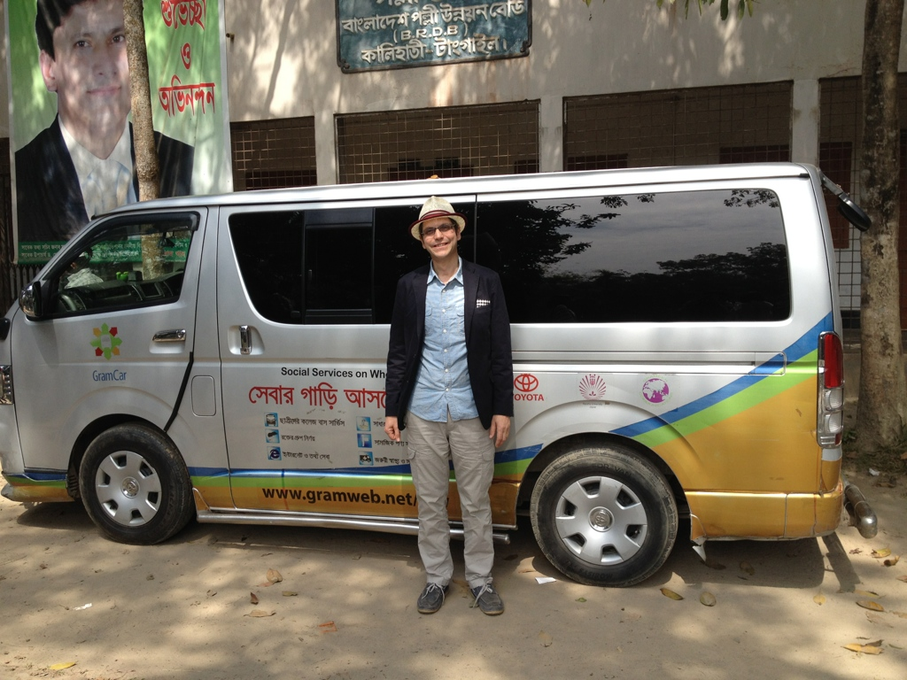
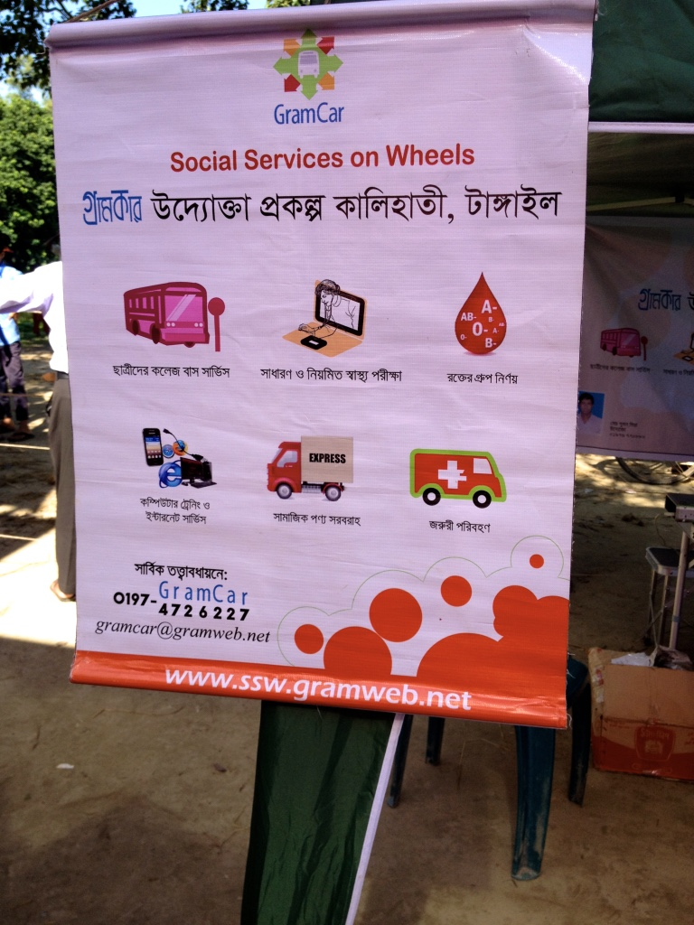
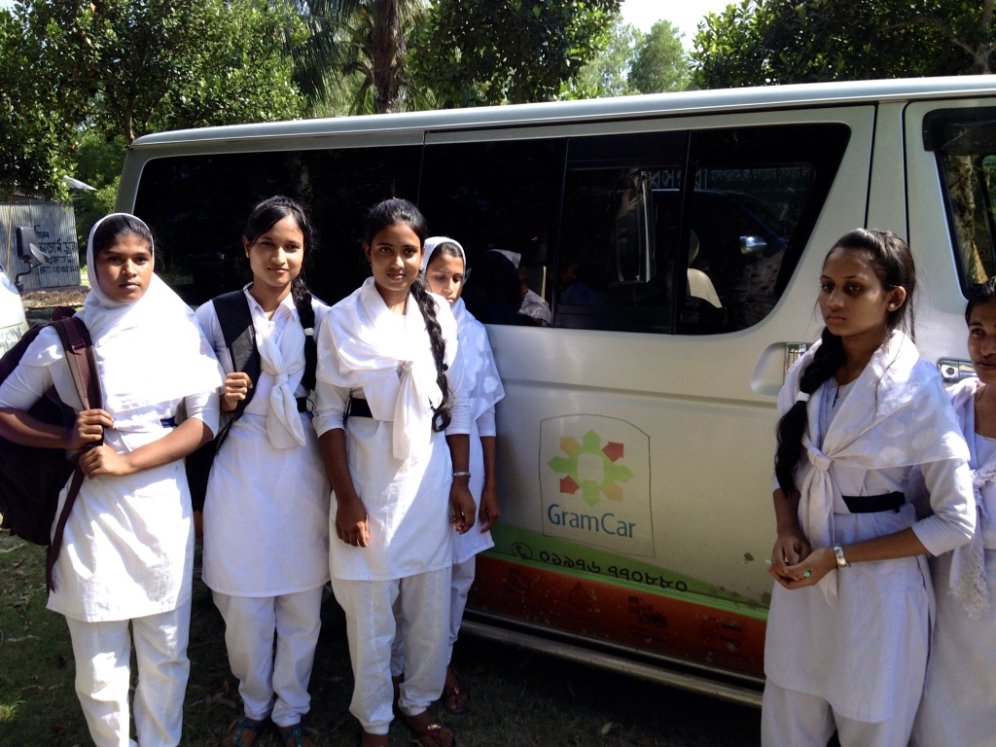
Uber type of approach for social services

Slide 38
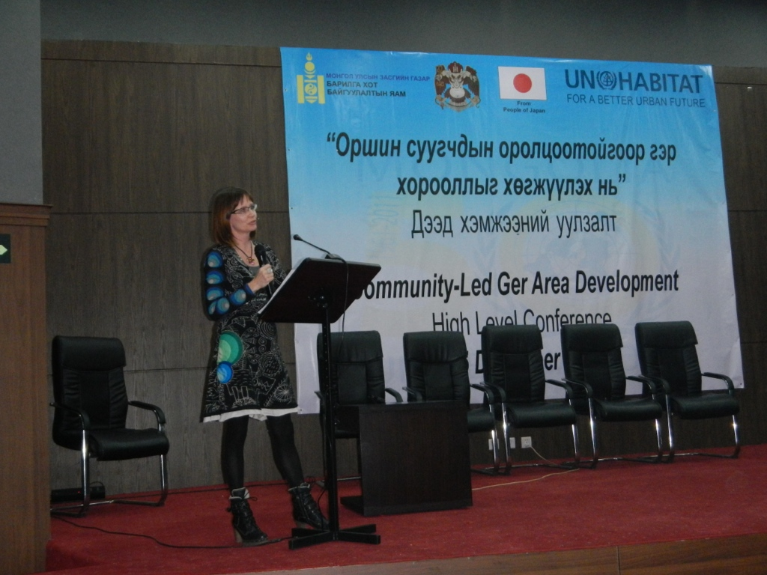
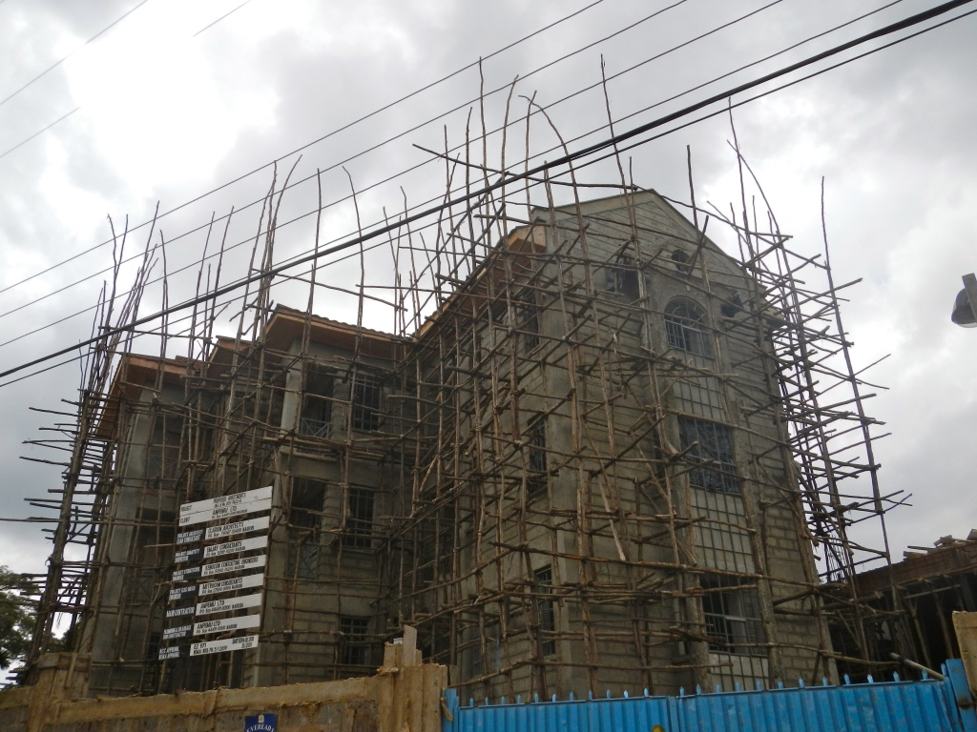
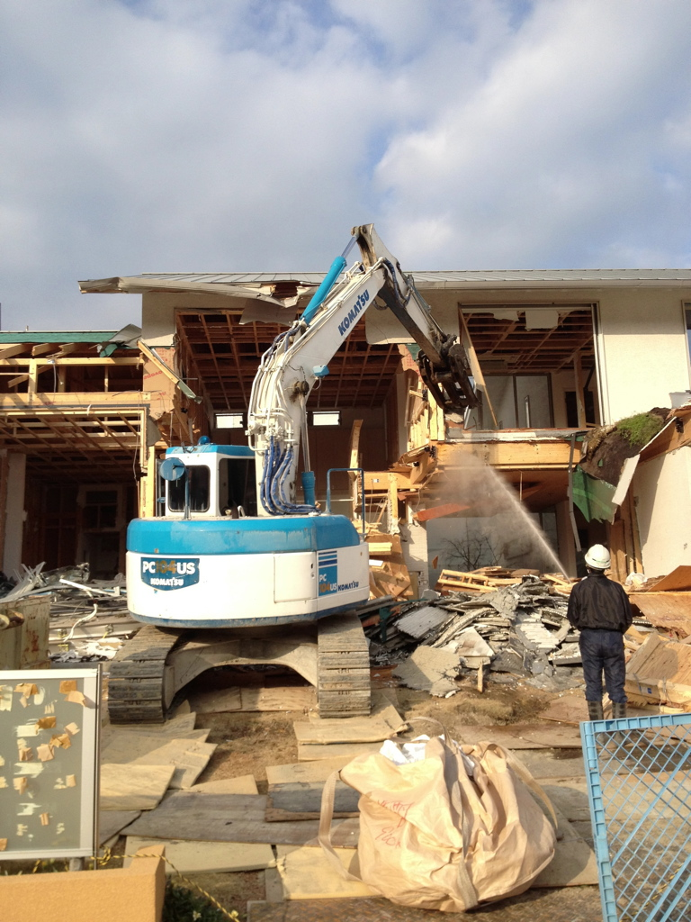
Social Business and Sustainable Housing and Infrastructure

Slide 39
Export B2B Social Business Solutions
Modular
Social
Benefit
Product
Service
National
Government
Bio-friendly
Local
Business
Service
Provider
Paying
Customers
Cost Effective
HW cost low/free
SW cost incremental
Build Service Providers Business
Paying
Customers
Paying
Customers

Slide 40


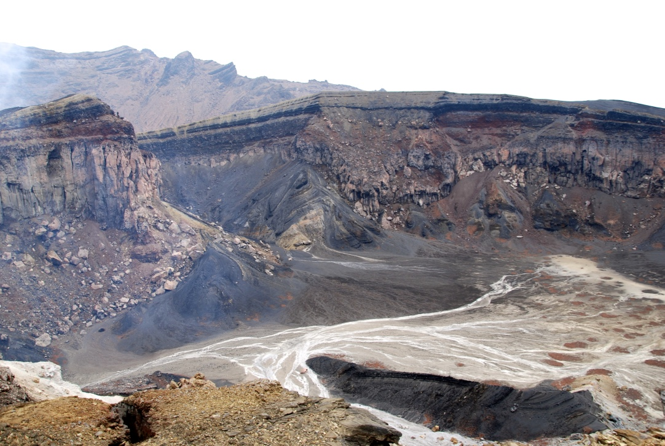
Social Business to cope with natural hazards

Slide 41
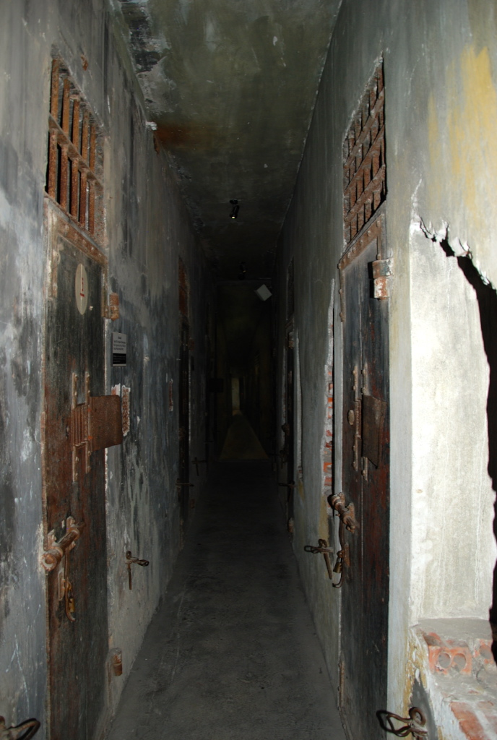
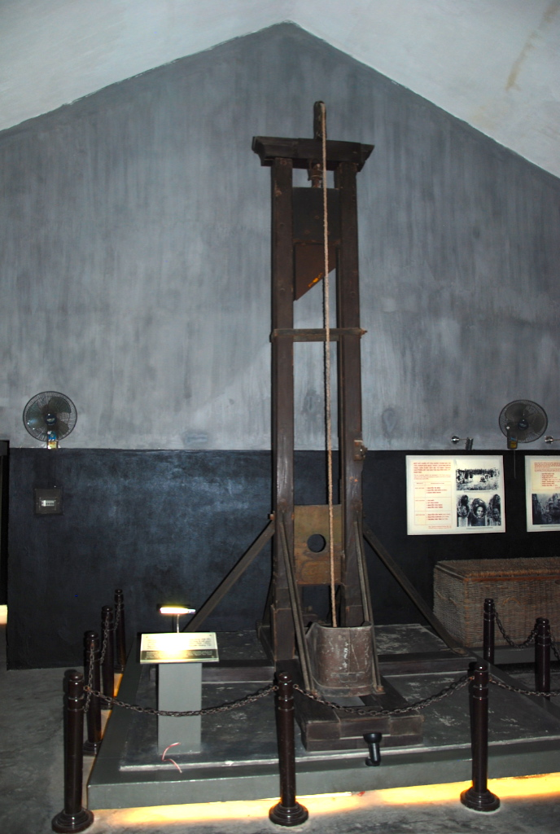
Social Business for human rights

Slide 42
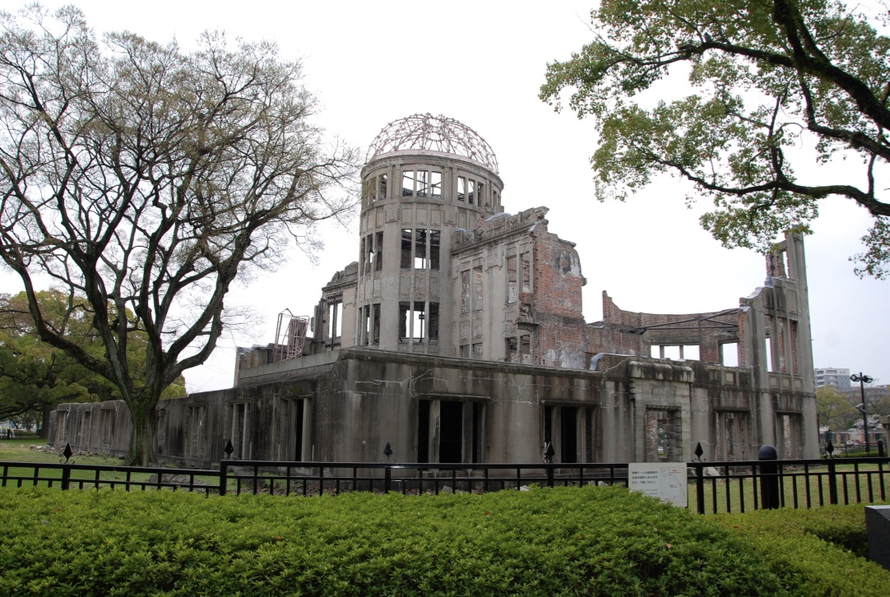
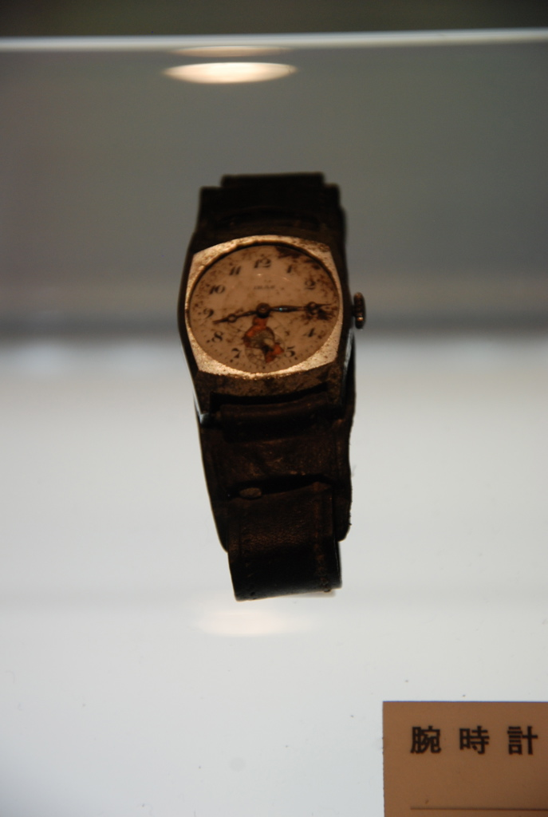
Social Business for world peace

Slide 43
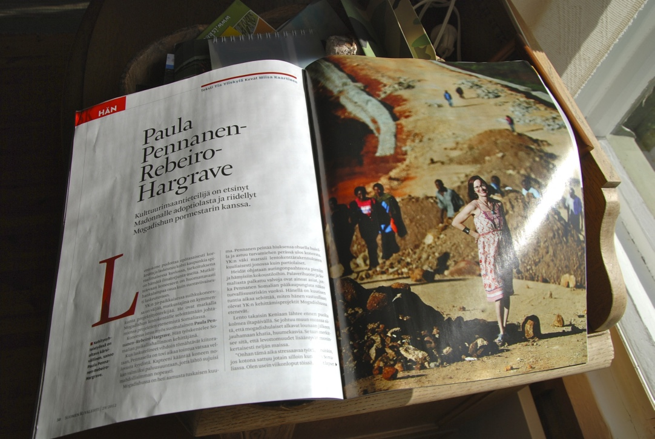
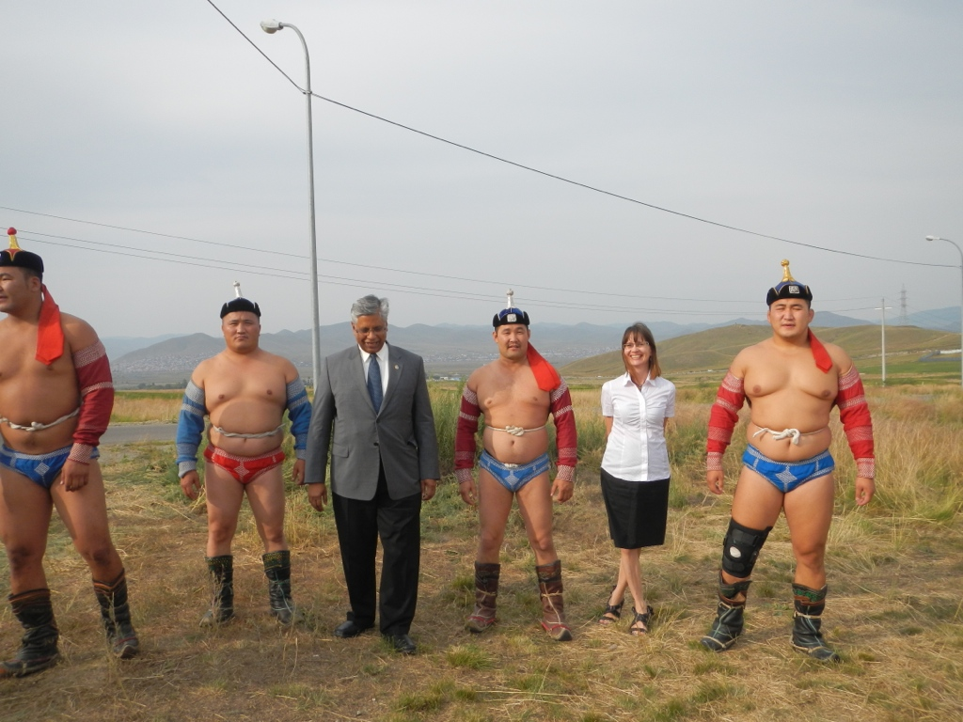


To sum up the world market for Finnish Social Businesses is immense
Mongolia
Somalia
Vietnam

Slide 44
THANK YOU!
Andrew Rebeiro-Hargrave
Academic Visitor, Aalto University, School of Science
Department of Industrial Engineering and Management

