Slide 1
Sector Differences
The Divergent Goals of Sector
Partners in Collaboration: Government,
Universities, and Industry Partners
Advisory Board Seminar of the MORFEUS Research Project
Open Innovation House, Otaniemi, Espoo, Finland
June 16, 2016

Slide 2
Do you agree on what collaboration is?

Slide 3
Sector Differences
What is Collaboration?
To work jointly with others or together especially in an intellectual endeavor
To cooperate with or willingly assist an enemy of one's country and especially an occupying force
To cooperate with an agency or instrumentality with which one is not immediately connected
Joint Action with parties (firms
or people) we do not typically work
with to accomplish a common goal.?

Slide 4
Who is in charge?
How do you structure activities?
How do you coordinate?

Slide 5
Sector Differences
What do you mean when you say you collaborate?
Multidisciplinary Interdisciplinary

Slide 6
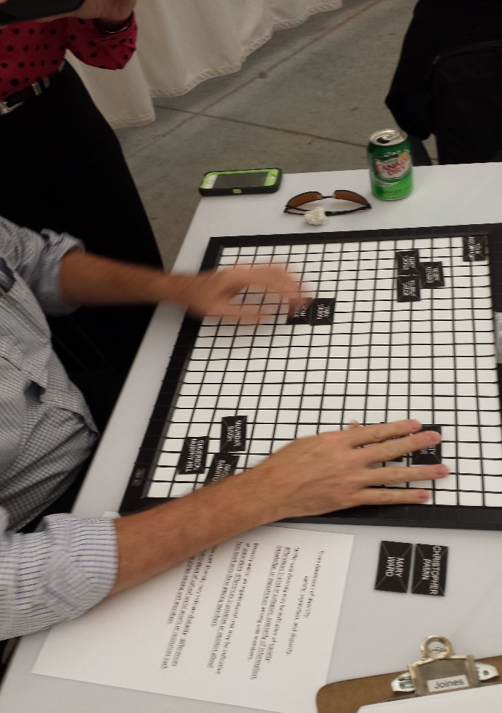
Sector Differences
Team diversity
effects collaboration
Motivations
Goals
Language
Norms of practice
Stakeholders

Slide 7
Sector Differences
Observations of Challenges in Multi-sector
Interdisciplinary Teams
Different Goals
Different Motivations
Meeting Logistics
Communication
Power
Conflict
Leadership
Changes in Membership

Slide 8
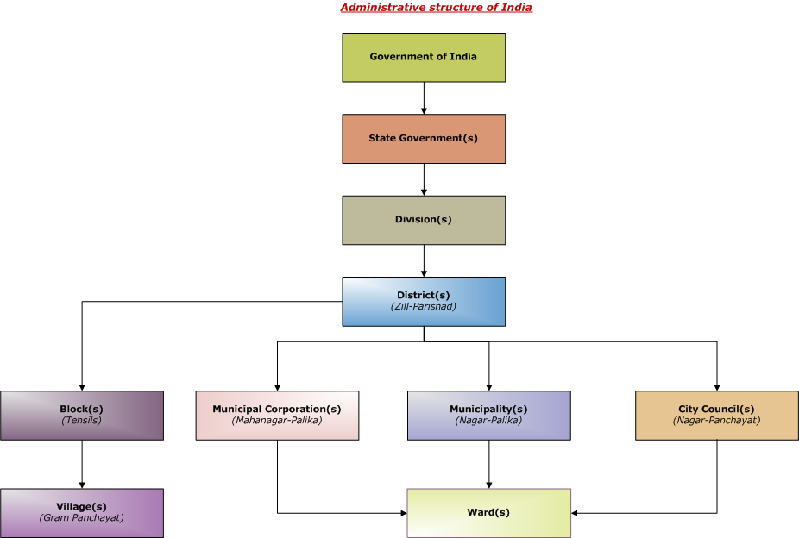
Sector Differences
Typical Attributes of Governments
Bureaucratic (This is the way it is done here!)
Slow to adapt and respond to trends
Hierarchical (top-down) decision making
Long, stable tenures for employees
Historical services provided
with little change
Slow paced, long time horizons

Slide 9
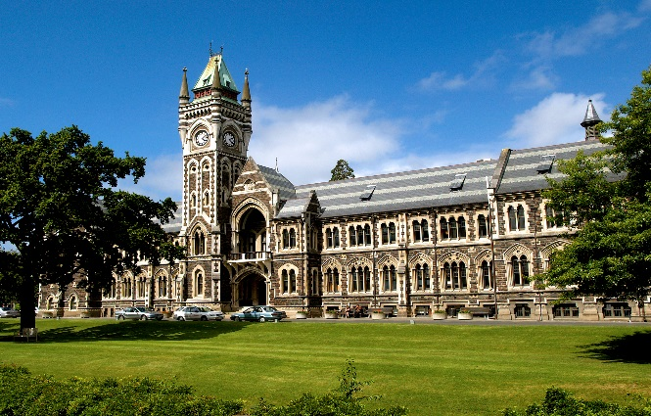
Sector Differences
Typical Attributes of Universities
Bureaucratic (This is the way it is done here!)
Moderately slow to adapt and respond to trends
Top-down & bottom-up decision making
Some stable tenures but some movement
Historical programs provided but also constant change in offerings to respond to trends
Moderate pace, moderate time horizons

Slide 10
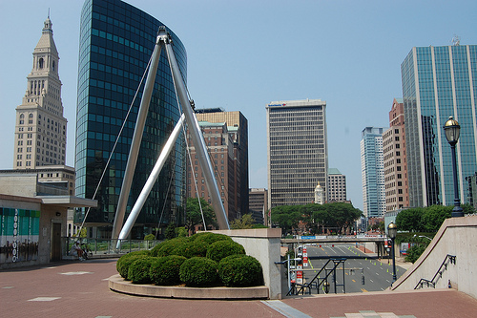
Sector Differences
Typical Attributes of For-Profit Firms
Some bureaucratic but many entrepreneurial
Adapt and respond to trends or do not survive
Less hierarchical, more agile
More employee movement in and out
Historical products and services often provided but also constant change to stay relevant
Faster paced, short time horizons

Slide 11
Sector Differences
Governments Goals
Keep the trains running (infrastructure)
Many goals & objectives (health, parks, water)
Respond to many stakeholders needs & wants
Focus on issues related to last election
Taxes pay for services and administration
Focus on the long term
and managing competing
goals of constituents

Slide 12
Sector Differences
Universities Goals
Keep the trains running (infrastructure)
Provide educational programs for students
Respond to students, parents and the public
Focus on issues linked to education (job market)
Paid for by indirect tax, often seen as free
Focus mid-range in nature

Slide 13
Sector Differences
For-Profit Firms’ Goals
Carefully assessment of industry trends
Mindful of potential value and cost of products and services, add new ones and drop old ones
Keep the stockholder, employees, and
customers happy
Make a profit regularly, eye on the near term

Slide 14
Sector Differences
Do an assessment of the challenges the project faces
caused by differences in sector partners.
Different Goals
Different Motivations
Meeting Logistics
Communication
Power
Conflict
Leadership
Changes in Membership
Implement short-term, medium-term and long-term strategies for overcoming the barriers between sectors

Slide 15
Sector Differences
What challenges does the MORFEUS Research Project face due to differences in sector partners?

Slide 16
Dr. Beverly Tyler
Poole College of Management
North Carolina State University
Tel: +1 (919) 621-1145
Beverly_Tyler@ncsu.edu

